Slide 1
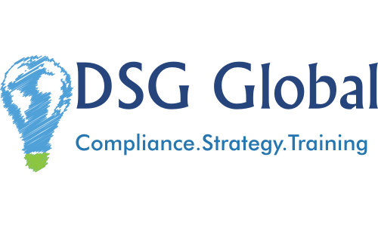

Slide 2
Overview
Who is DSG Global?
Benefits of International Trade Compliance
What services does DSG Global provide?
Customers & Testimonials

Slide 3
Who is DSG Global?
Consulting firm focused on International Trade compliance and training | Headquartered in San Francisco with team members around the United States | CEO Deep SenGupta co-founded/managed FedEx’s trade consulting group from 2002-2014

Slide 4
Benefits of International Trade Compliance
A strong International trade compliance
program will help reduce
Landed cost & customs duties | Shipment delays | Avoidable import/export penalties

Slide 5
Solutions - Packages
Virtual Compliance | Tariff Buster Analysis™️ | Turn-key Compliance

Slide 6
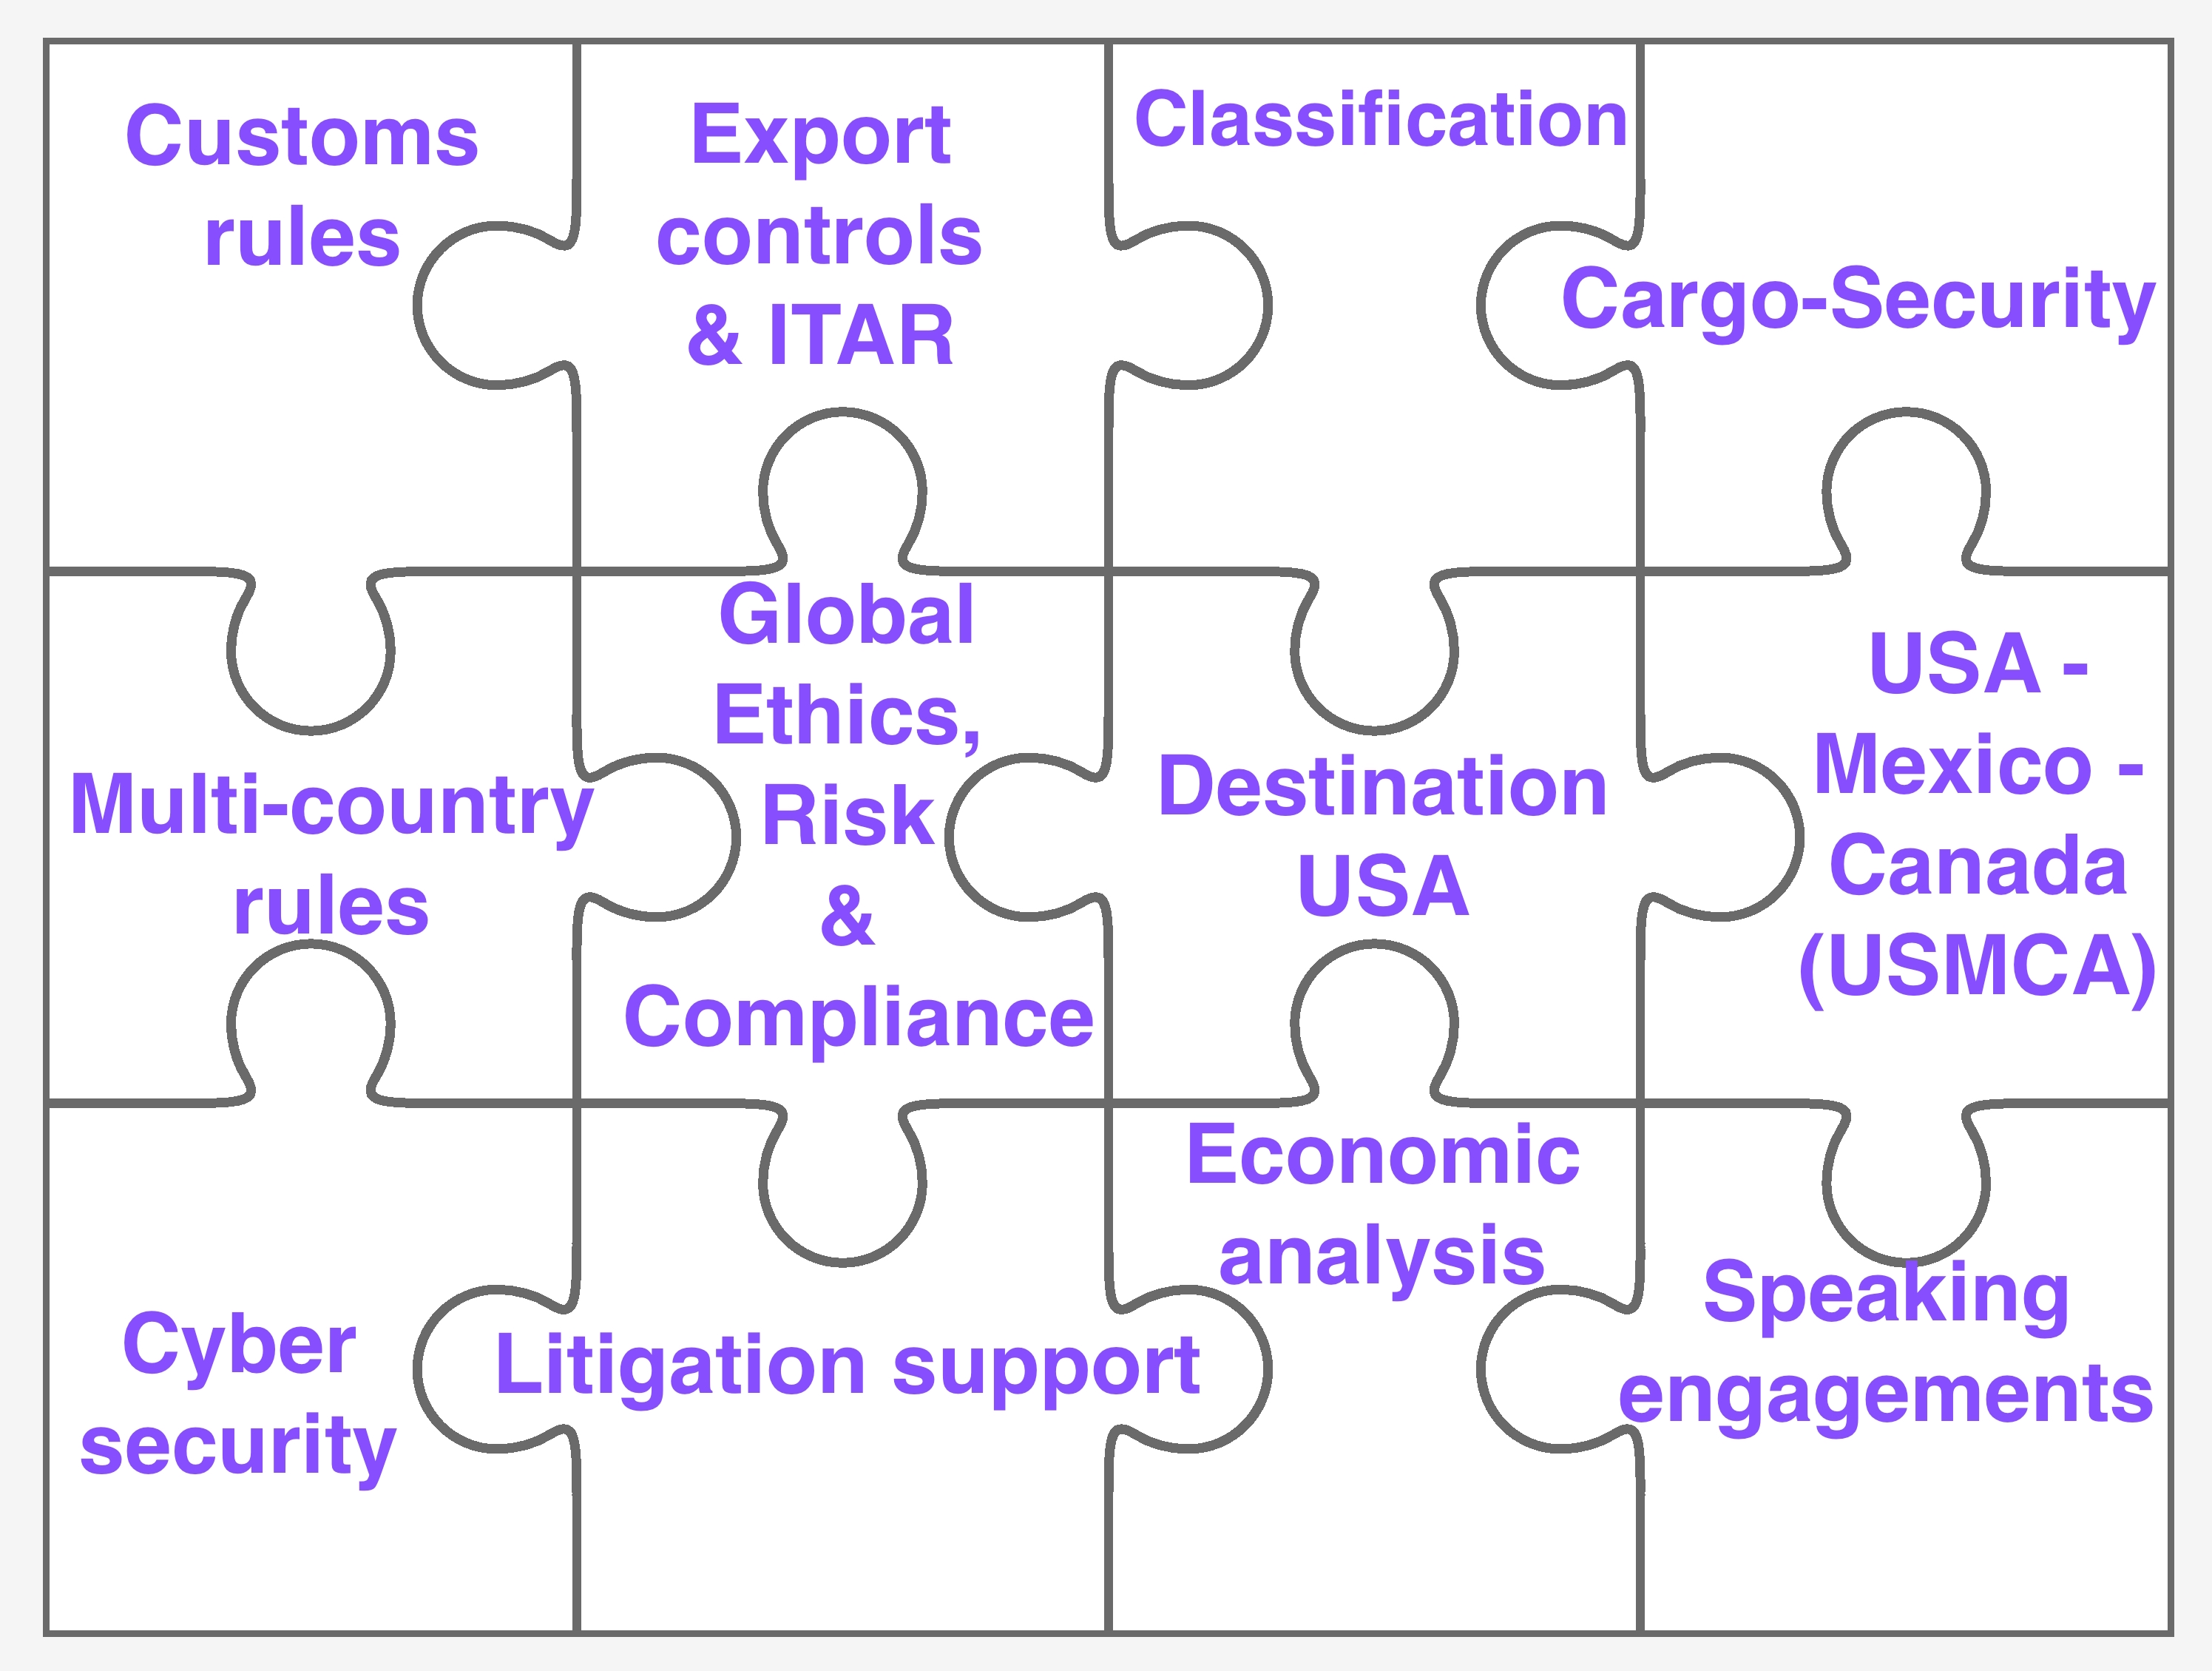
Solutions - Services

Slide 7
Customers & Testimonials
CUSTOMER TESTIMONIALS
dsgglobal.com/clients
Representative Customer Projects
Pharma & Life Sci. | Electronics & IT | Telecom. | Automotive | Aviation | Industrial | Apparel | Retail
Alcon CibaVision Fitbit Millipore Sigma | DELL Samsung Curvature Avnet | Viptela Panasas Novatel Digi Corp. | CNH Isuzu Yazaki Bridgestone Remy | Aerozone Amsafe Heatcon Heath Tecna Rolls Royce | Mettler Toledo Graham Packaging Foxconn | Gymboree Hot Topic G.Hensler LL. Bean Zazzle | E&J Gallo Fender P&G PING Golf

Slide 8
Thank You!
Deep SenGupta, LL.M
Chief Executive Officer
+1 (415) 741-7526 | deep@dsgglobal.com | dsgglobal.com

